Slide 1


Gen AI-Based Email Gatekeeper Service
Archana Paliath
Veena Kumari Reddypally
Prerna Kumari
Prameet K Pradhan
Ravikanth Pratti

Slide 2
Agenda
Problem Statement
Proposed Solution
Challenges Faced
Architecture Diagram
Summary
Team

Slide 3
Problem Statement
Consumer Landing departments of banks typically handle a high volume of requests from customers. These requests often come in the form of emails, PDFs, and Word documents and contain a variety of requests related to customer services (e.g., account issues, loan inquiries, etc.).
Manual processing of these requests can be time-consuming, error-prone, and inefficient. Employees often have to read through long emails or documents, extract relevant information, and classify requests manually.
There is also the challenge of identifying duplicate requests (e.g., if the same customer submits the same request multiple times).
Additionally, the requests need to be processed based on priority (e.g., urgent loan requests, customer complaints).

Slide 4
Key Problems
1
2
Time-Consuming Manual Processing: Employees waste time reading and categorizing requests
Difficulty in Identifying Request Type and Subtype: Requests can vary in format, requiring complex rules to categorize them
3
4
Duplicate Requests: Some customers might submit the same request more than once, leading to redundancy
Priority Handling: Requests need to be prioritized for efficient handling.

Slide 5
Proposed Solution
Gen AI-Based Email Gatekeeper Service

Slide 6

Primary Objectives
The service will use AI and NLP models (using OpenAI’s API) to automatically process and extract data from emails, PDFs, and Word documents.
Based on the extracted keywords, the system will identify the request type and subtype (e.g., loan request, account-related request, etc.).
The system will check for duplicate requests by generating hashes and persisting to compare incoming requests against historical ones.
A priority classification mechanism will be implemented to determine the urgency of the requests (e.g., money movement requests)

Slide 7
Components
Document Parsing & Data Extraction
Request Classification (AI Model)
Duplicate Detection
Use Python libraries like pdfminer, python-docx , email to extract text from PDFs, DOCX, and emails.
Implement NLP techniques to process and extract meaningful data (e.g., customer name).
Use Open AI's GPT model to process the text and classify the request type and subtype.
Compare new requests with past requests using a content hash (or similarity algorithms) to identify duplicates.
Priority Assessment
Output
Classify the urgency of the requests based on money movement keywords
Processed requests will be classified with a priority level for quicker handling.

Slide 8
Tech Stack
OpenAI GPT
Python Libraries
MongoDB

Slide 9
Challenges Faced
Data Quality and Extraction
Duplicate Detection
Priority Handling
Extracting structured data from unstructured emails, PDFs, and DOCX files can be tricky. Text extraction may not always be clean, leading to noisy data for processing.
Identifying exact duplicates across different formats (e.g., an email and a PDF with the same content) can be challenging. We need to handle cases where a request is similar but not identical.
Automatically determining the priority of a request is not always straightforward. Requests may require additional contextual understanding that the AI needs to infer from keywords and context.
Training the AI Model
Scalability
The OpenAI free tier may have limitations on the number of requests and usage, so the challenge is to fine-tune the AI model with limited data and ensure it can generalize well to unseen requests.
The system needs to be efficient enough to process large volumes of incoming requests in real-time or near-real-time.

Slide 10
Architecture Diagram

Slide 11
Customer Request
(Email, PDF, DOCX)
Document Parsing
(pdfminer, python-docx)
Extracted Text & Metadata
NLP Model (OpenAI) (Request Type & Subtype Identification)
Duplicate Detection
(Similarity/Hashing)
Priority Classification
(Urgency Assessment)

Slide 12
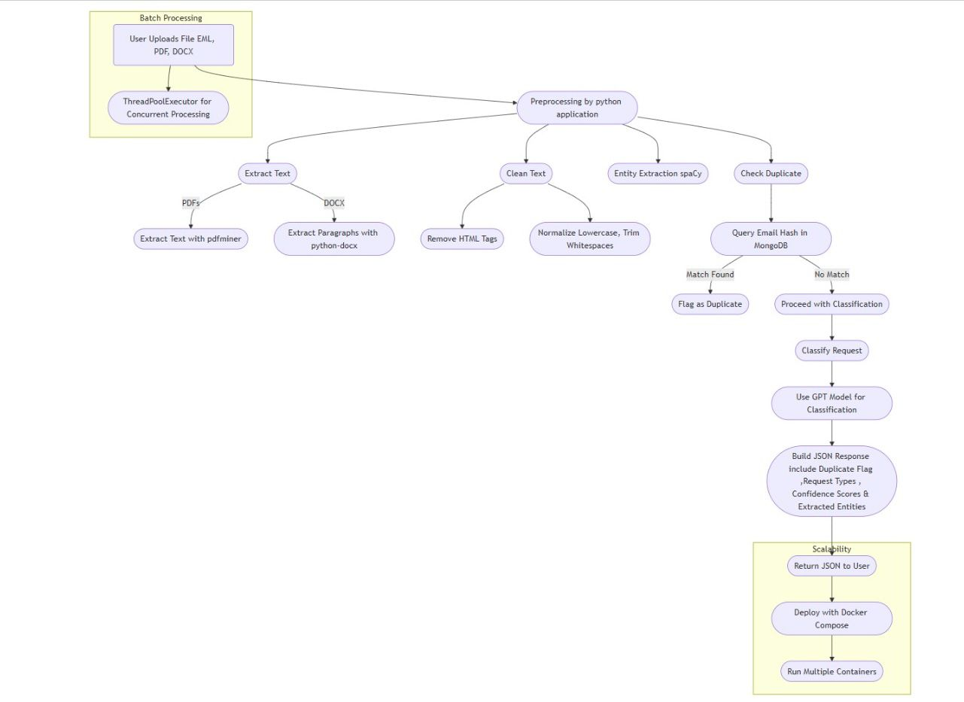

Slide 13

Thank You

Slide 14
Design
Document Parsing
NLP Model (OpenAI)
Duplicate Detection
The system first extracts the raw text from these different formats using tools like pdfminer for PDFs, python-docx for DOCX files, and the email library for parsing emails.
The extracted text is passed to OpenAI's GPT model to classify the request's type and subtype (e.g., loan request, account inquiry).
A module to check whether the incoming request is a duplicate of a previous one using similarity measures or content hashing.
Priority Classification
Customer Request (Email, PDF, DOCX):
Classify the urgency of the requests based on money movement keywords
Customers send their requests via email, PDF, or Word document.

